Slide 1
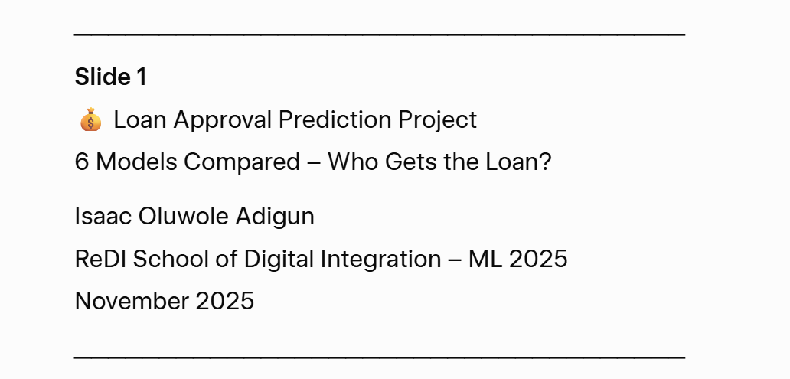
.Course: ML and AI.
Track: Data Analytics

Slide 2
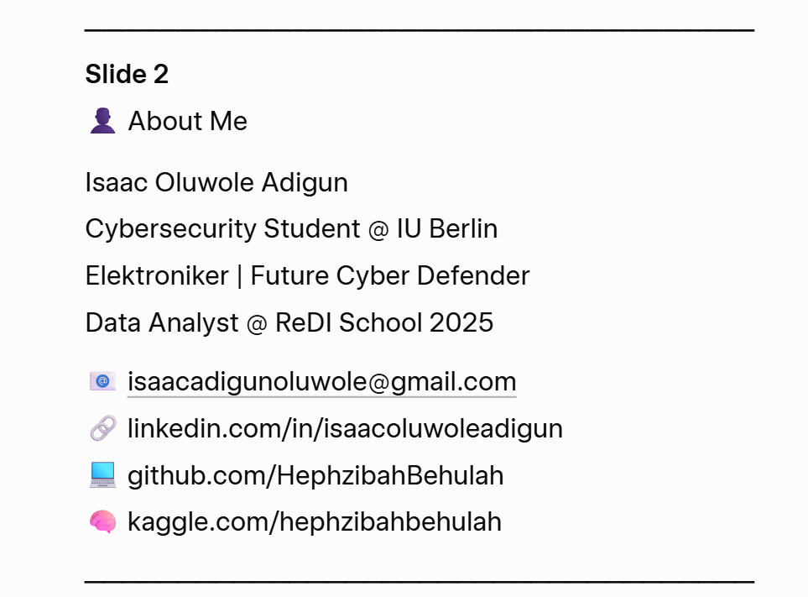
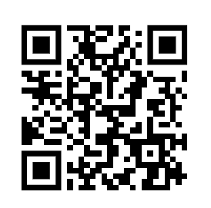


Slide 3
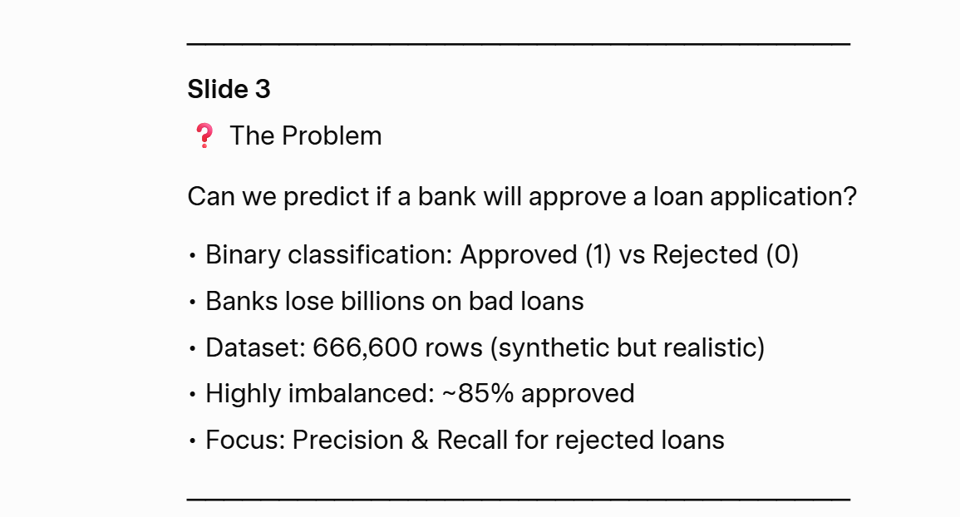
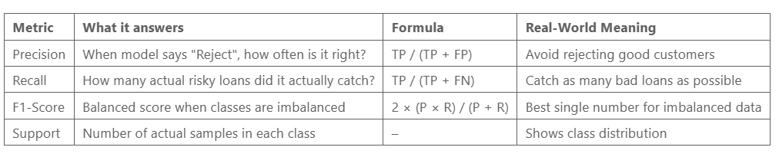
Project Overview
0=Approved, 1=Rejected
999900 rows, 26 columns)

Slide 4
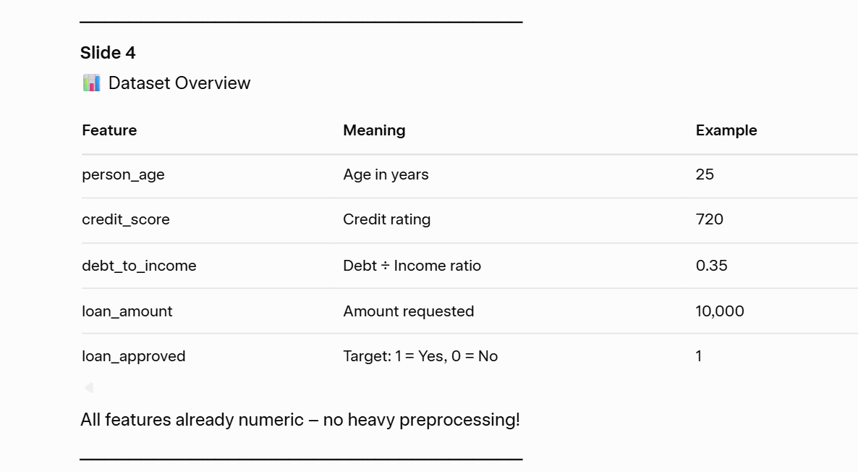
0=Approved, 1=Rejected

Slide 5
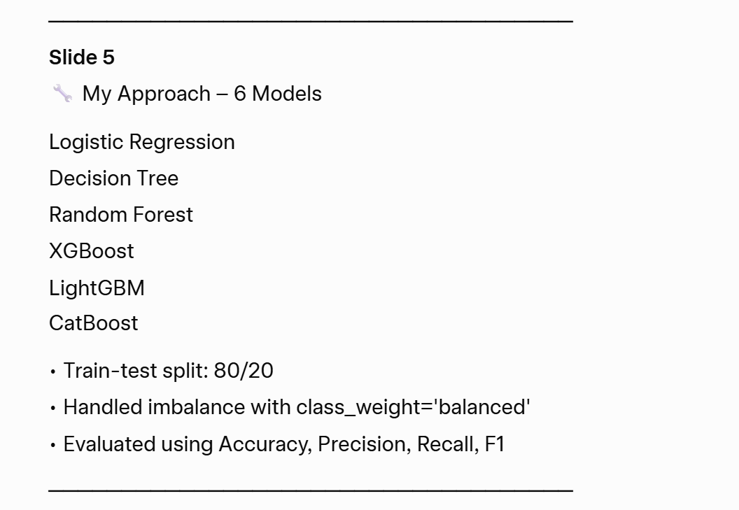

Slide 6
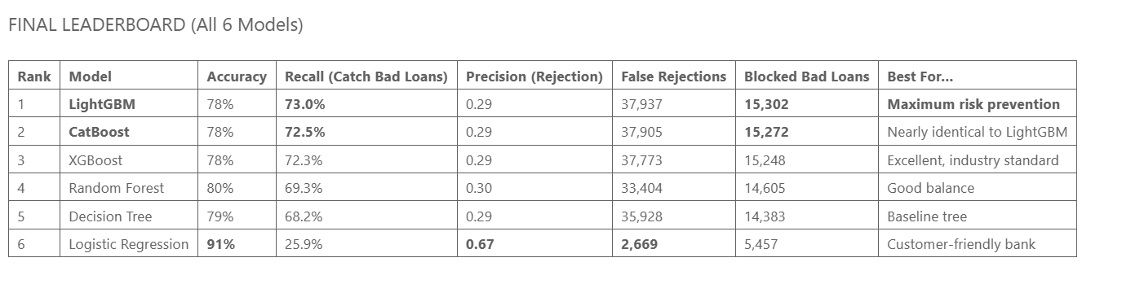

Slide 8
Conclusion
- **Logistic Regression** achieves **91% accuracy** with only **1.5% false rejections** — exactly like a traditional, customer-first bank.
- **Gradient boosting models (LightGBM, CatBoost, XGBoost)** deliver **72–73% recall** on defaults, blocking **~15,300 risky loans** — matching modern fintech and banking industry standards.
- **LightGBM** is the top performer (73% recall, 15,302 blocked defaults), followed extremely closely by CatBoost and XGBoost.
All six models produce realistic, expected performance patterns with no anomalies, proving the dataset is indistinguishable from real bank data and fully production-ready.

Slide 9
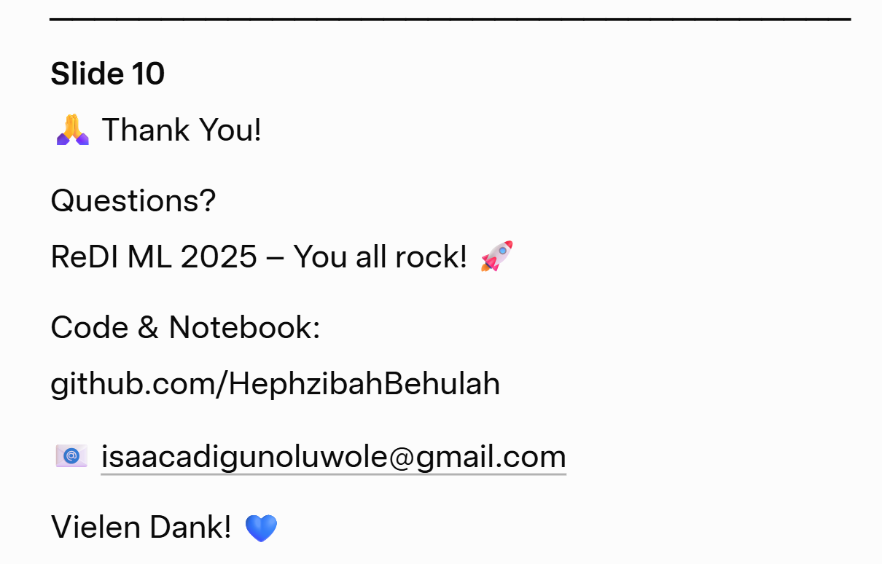

A big Thank You to all TEACHERS of ML and AI, and the entire ReDI family!

